Slide 1
SQL HW1
Shaojie Carter Zhang

Slide 2
Code for constructing data
SELECT * FROM hw1_table;
insert into hw1_table
values('aaba', 55, 54, 60, 50);
select * from hw1_table;
insert into hw1_table
values('bbb', 32, 43, 50, 25),
('ccc', 88, 95, 100, 89),
('ddd', 16, 15, 16, 16),
('eeabe', 34, 25, 34, 20);

Slide 3
Code for 1-4
select * from (hw1_table)
where (low between 30 and 50);
select * from hw1_table
where cusips like '%ab%';
select * from hw1_table
where open > 30
Or low < 50;
select * from hw1_table
where high > 30
And close < 50;

Slide 4

Output for 1

Slide 5
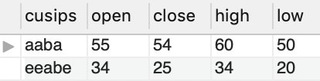
Output for 2

Slide 6
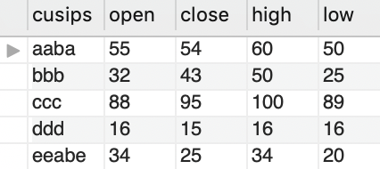
Output for 3

Slide 7
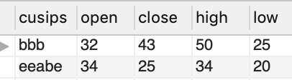
Output for 4

